Slide 1
UNICORN COMPANIES ANALYSIS
AKSHAT JAIN

Slide 2
About the Project
About the Data
Data Cleaning
Data Exploration
Data Visualization Dashboard
CONTENTS

Slide 3
ABOUT THE PROJECT
This project provides insights into the characteristics of unicorn companies (companies whose values are over 1 billion dollars). In particular, it will find the answers to the following questions:
Which unicorn companies have had the biggest return on investment?
How long does it usually take for a company to become a unicorn?
Which industries have the most unicorns?
Which countries have the most unicorns?
Which investors have funded the most unicorns?

Slide 4
ABOUT THE DATA
The dataset used in this analysis contains records of 1074 unicorn companies obtained from Maven Analytics' official website.
The sample size reduces to 1060 due to the lack of funding and inaccurate information on the year companies are found.
Microsoft Excel was used for the initial setup before importing to SQL server.

Slide 5
DATA CLEANING
In this project, we mainly used SQL for both data cleaning and exploration.
Data cleaning steps include:
Check for duplicates
Drop rows with errors
Reformat currency values (e.g. $2M => 2,000,000)
Delete unused columns

Slide 6
DATA EXPLORATION
SQL skills used:
Joins
Common Table Expressions (CTEs)
Aggregate Functions
Data Types Conversion
Relational operators

Slide 7
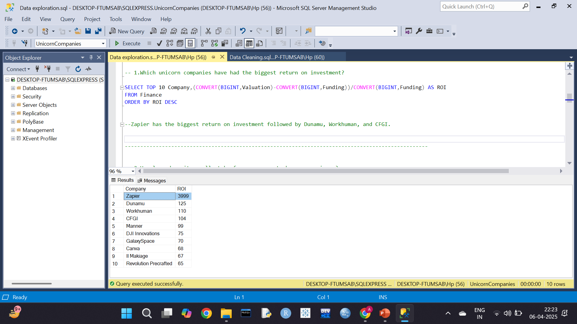
DATA EXPLORATION
1. Which unicorn companies have had the biggest return on investment (ROI)?
This query output shows the top 10 companies with the biggest ROI. Zapier achieved the biggest ROI of 3999%. Dunamu comes second with 125% ROI, and Workhuman is third with 110% ROI.
Zapier’s ROI is significantly high compared to other
companies.

Slide 8
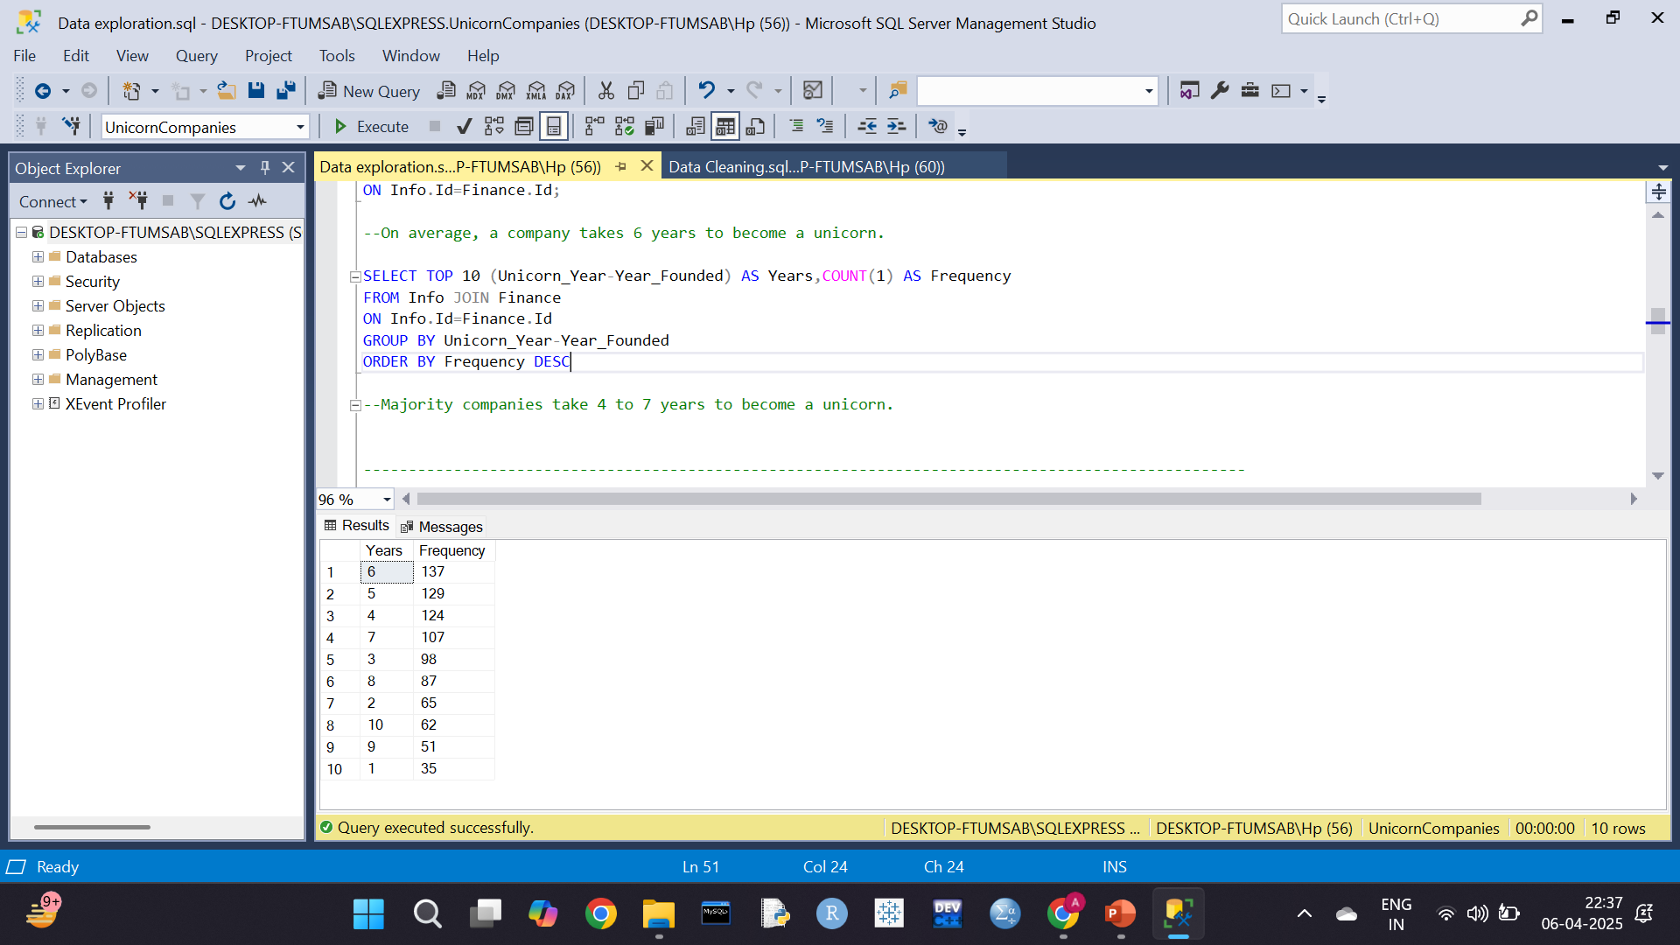
DATA EXPLORATION
2. How long does it usually take for a company to become an unicorn?
On average, a company takes about 6 years to become an unicorn.
The majority of companies could become an unicorn within 4 to 7 years.

Slide 9
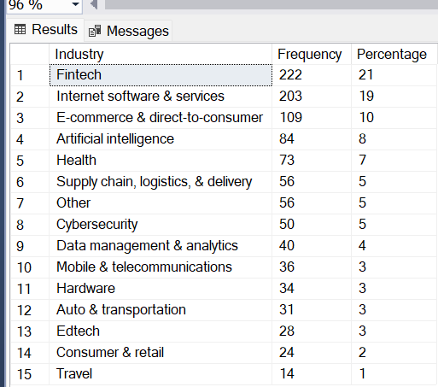
DATA EXPLORATION
3. Which industries have the most unicorns?
Fintech and Internet Software & Services have about 40% of total unicorns.
The e-commerce industry also has a
significant share of unicorns of 10%.
These figures show the potential of Fintech, Internet software & services, and E-commerce industries.

Slide 10
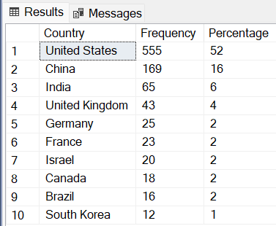
DATA EXPLORATION
4. Which countries have the most unicorns?
It is interesting (but not surprising) that the United States has the largest share of unicorns.
China and India, the countries with the largest share of the world population, have 16% and 6% share of unicorns, respectively.

Slide 11
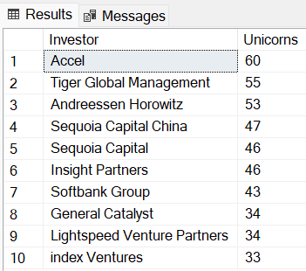
DATA EXPLORATION
5. Which investors have funded the most
unicorns?
This query output shows Accel is the top investor who has invested in 60 unicorns.
Here, Sequoia Capital and Sequoia Capital China are treated as different investors. The details are beyond the scope of this project.

Slide 12
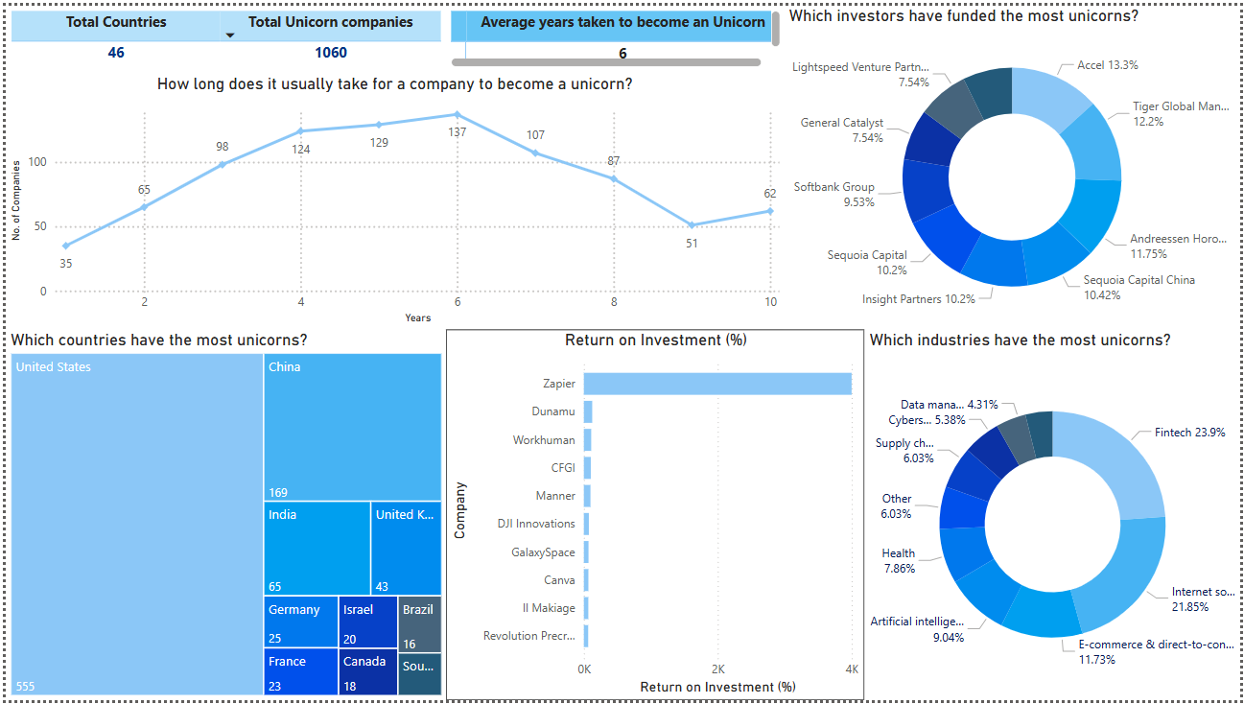
DATA VISUALIZATION (POWER BI)

Slide 13
THANK YOU!

